Slide 1

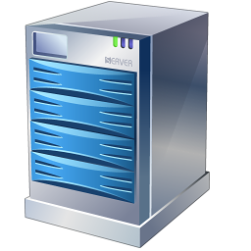

Security Policy Evaluation Flow
  Cookie Security
  Global ACLs
  Parameter Protection
  URL Normalization
  URL Protection
  Action Policy
  Request Limits
Request
Tommy
Response
Application
Server
Smart Signatures are enforced at the relevant stages based on the incoming request
  Cloaking
  Data Theft Protection

Slide 2
Evaluation Flow with Advanced Security
  URL Policies
  Session Tracking
  Cookie Security
  Global ACLs
  Parameter Protection
  URL Normalization
  URL Protection
  Action Policy
  Request Limits
Request
Tommy
Response
Application
Server
Smart Signatures are enforced at the relevant stages based on the incoming request
  Cloaking
  Data Theft Protection

